Slide 1
meet.google.com/ows-sazk-dsw

Slide 2
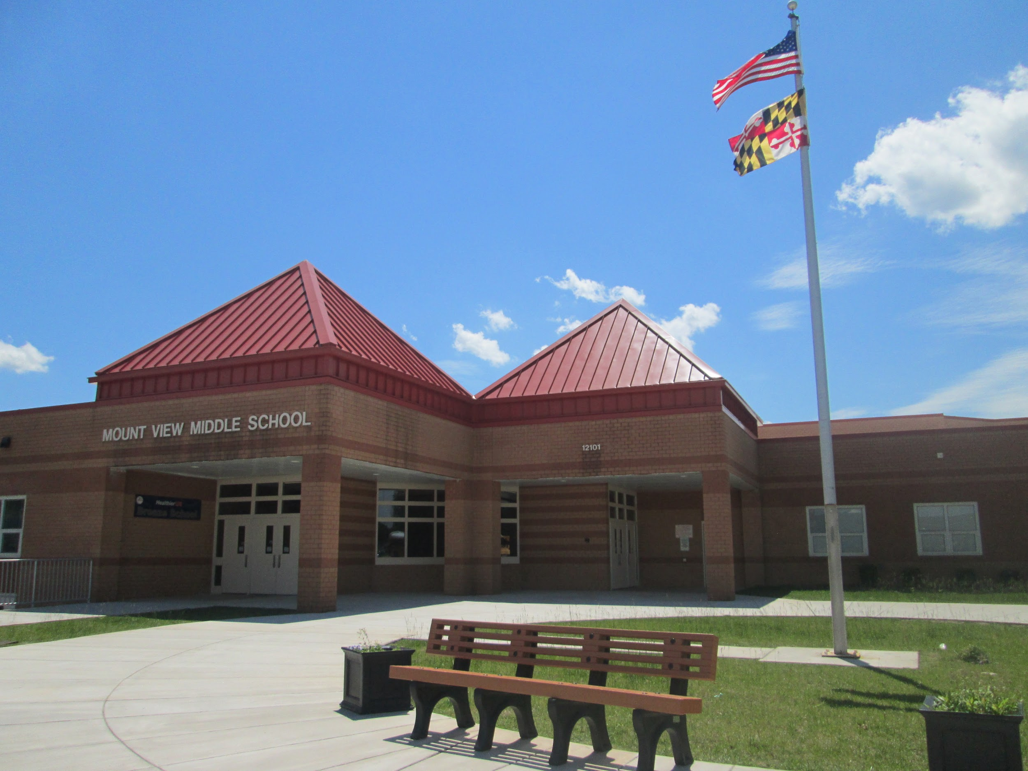
Welcome to
Mount View Middle School
Home of the Falcons
Notes:
Admin

Slide 3
Meet the 8th Grade Teachers!
Video

Slide 4
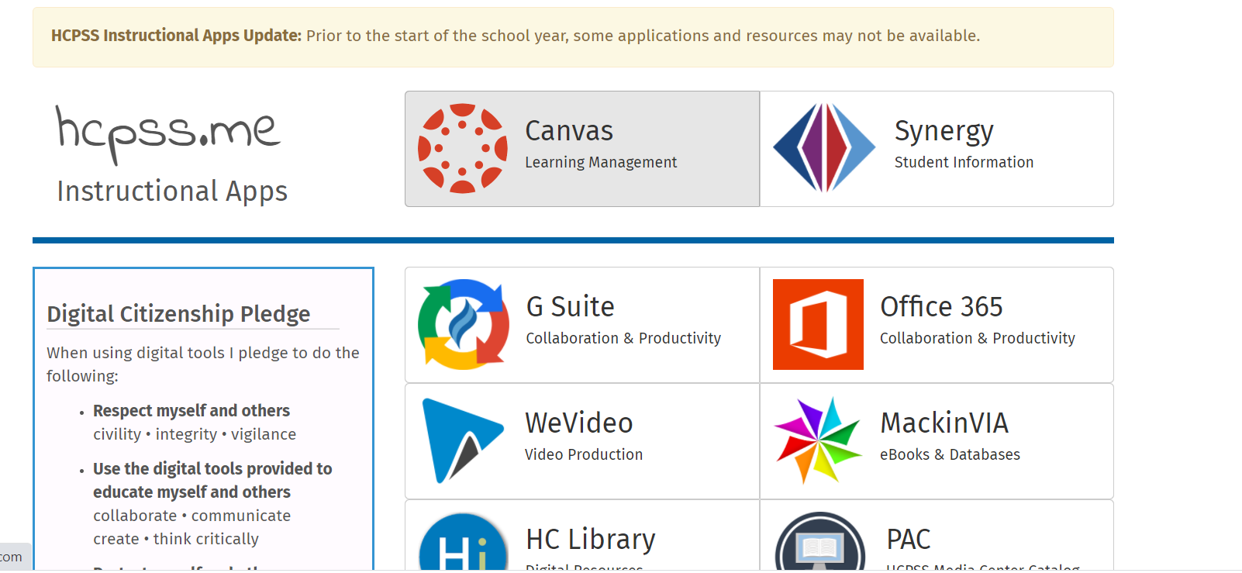
Hcpss.me

Slide 5
Top 10 Tips For A Successful School Year
Notes:
Student Schedule

Slide 6
#1. Eat a healthy breakfast each morning.
Notes:
Top 10

Slide 7
#2. Be on time for class.
Notes:
1

Slide 8
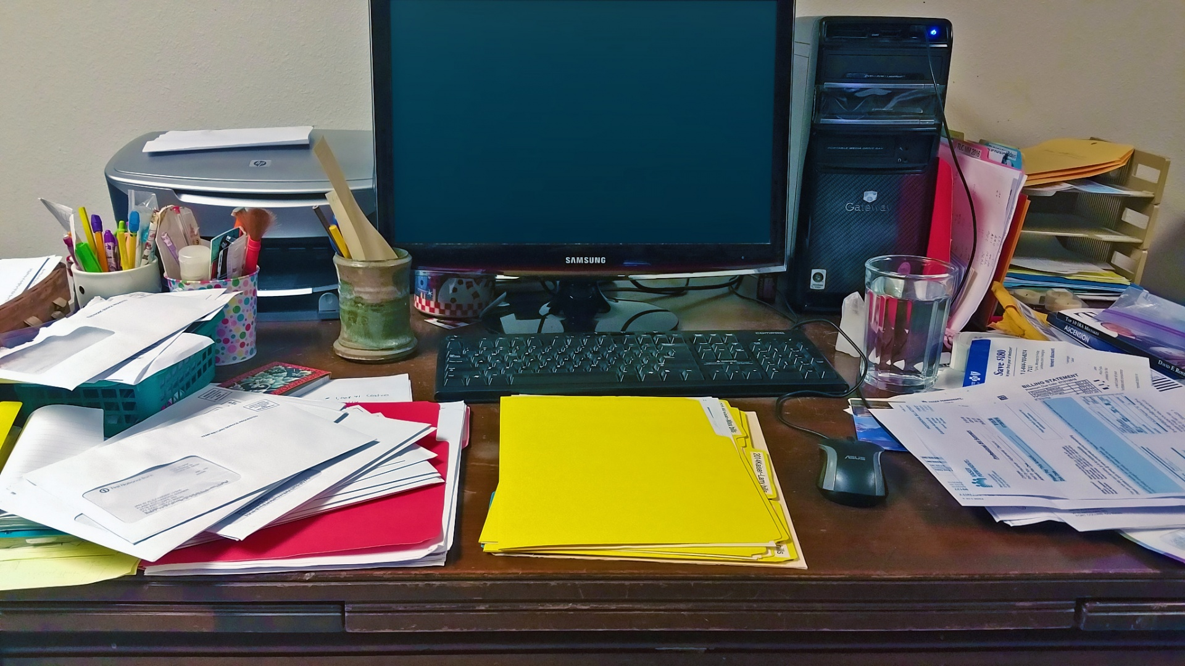
#3. Have a dedicated space to complete your work.
But make it neater than this one!
Notes:
2

Slide 9
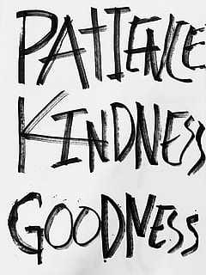
#4. Be kind to others.
Notes:
3

Slide 10
#5. Ask for help when you need it.
Notes:
4

Slide 11
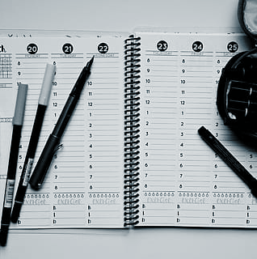
#6. Make a schedule and
stick to it.
Notes:
8

Slide 12
#7. Get plenty of rest at night.
Notes:
7

Slide 13
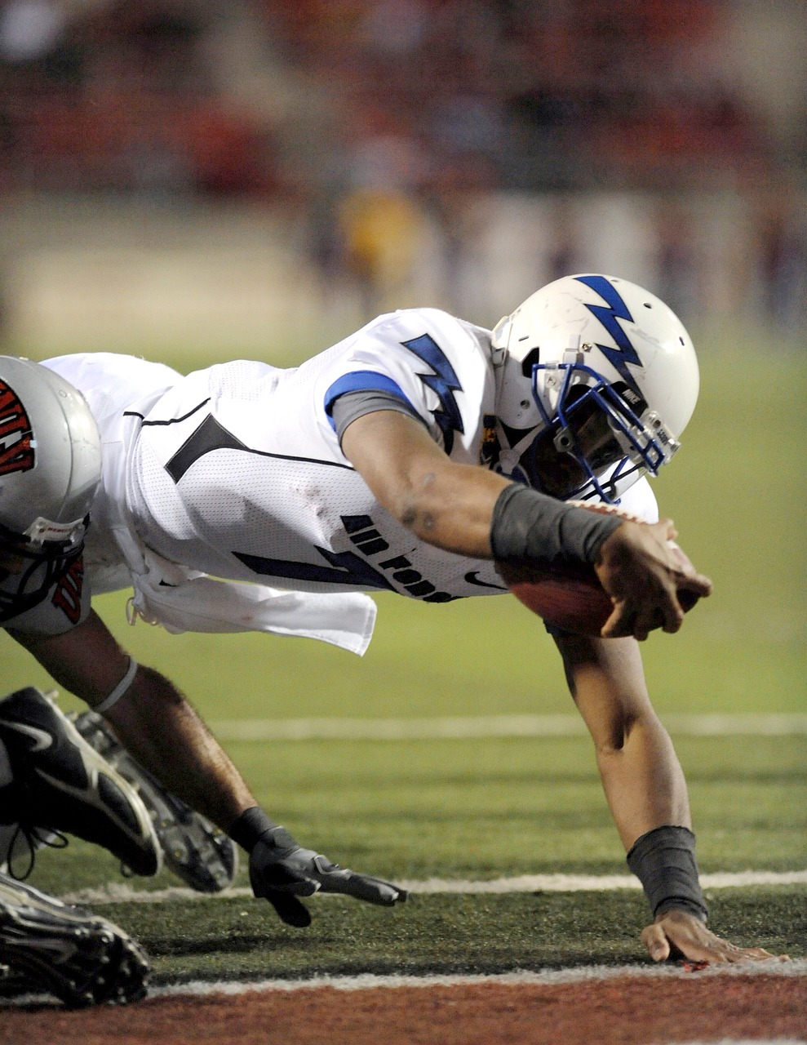
#8. Give your best effort.
Notes:
9

Slide 14
#9. Stay positive and believe in yourself.
Notes:
10

Slide 15
#10. Have fun and learn something new!
Notes:
6

Slide 16
Getting ready for the first day of school
Make sure your device is charged and ready
Have a positive attitude
Be ready to learn
Be ready to meet and make new friends
Check your teacher’s Canvas pages for the meeting codes for the virtual meetings
Notes:
Break out time for 1st period classes

Slide 17
Q & A Time

