Slide 1
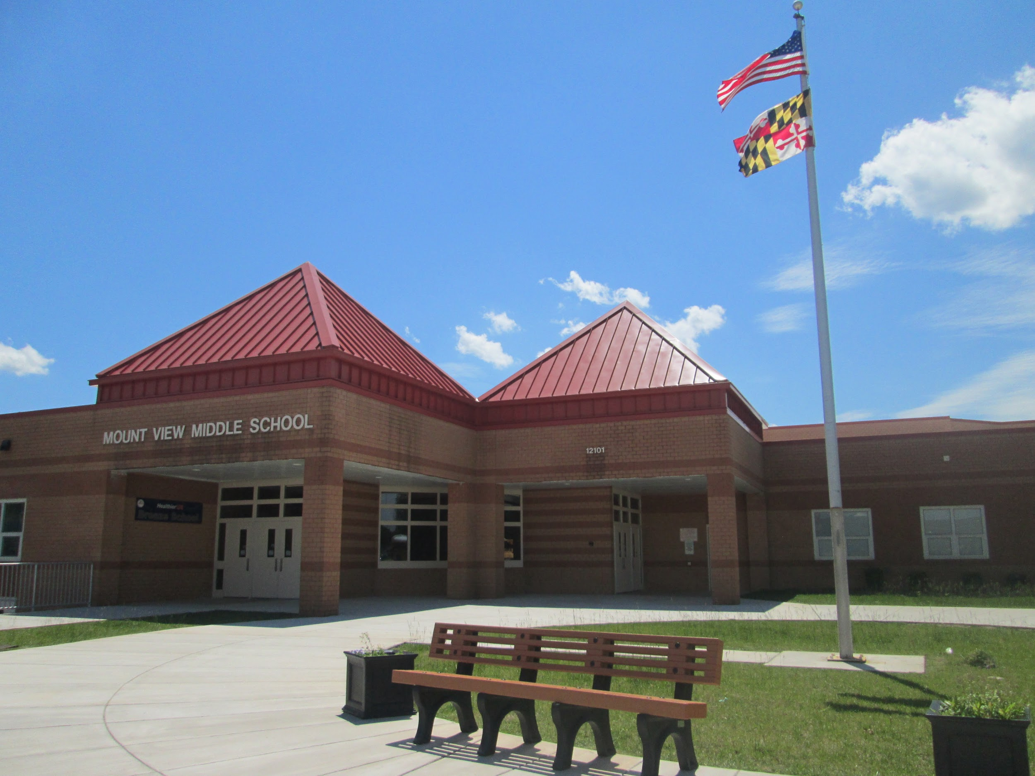
Welcome to 7th Grade at
Mount View Middle School
Home of the Falcons
Notes:
Admin

Slide 2
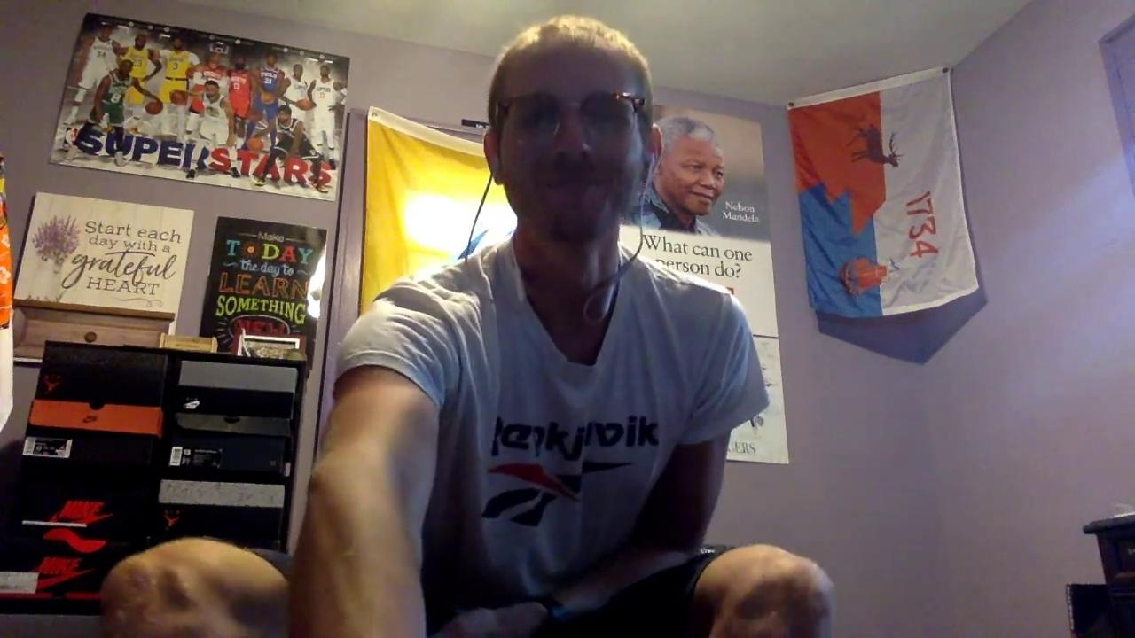
Meet the 7th Grade Team
Mr. Walsh - Social Studies
Mr. Dubbs - Social Studies & Digital Citizenship
Ms. Sorenson - Math
Ms. Bassolino - Math
Mr. Ford - ELA & Digital Citizenship
Ms. Kann - ELA
Ms. Stout - Science
Ms. Otto - Science
Mr. Biniak - Social Studies
Notes:
Walsh, Dubbs, Sorenson, Bassolino, Ford, Kann, Otto, Stout, Biniak

Slide 3
Meet the Related Arts Team
Ms. Strickler: Spanish | Mrs. Grimes: Chorus and Music
Ms. Costello:French | Mr. Sindler: Band
Mrs. Bateman: Band & Music | Mrs. Bateman: General Music and Band
Mrs. Kuruc: Art | Mr. DeBeal: Orchestra
Mr. Mitchell: Art | Mrs. Marble, Mr. Tucci & Ms. Parson: Health
Mrs. Balimtas and Mrs. Capecci: Reading Seminar | Mr. Blum and Mr. Tucci: PE
Notes:
Strickler ,

Slide 4
Top 10 Tips For A Successful School Year
Notes:
Student Schedule

Slide 5
#1. Eat a healthy breakfast each morning.
Notes:
Top 10

Slide 6
#2. Be on time for class.
Notes:
1

Slide 7
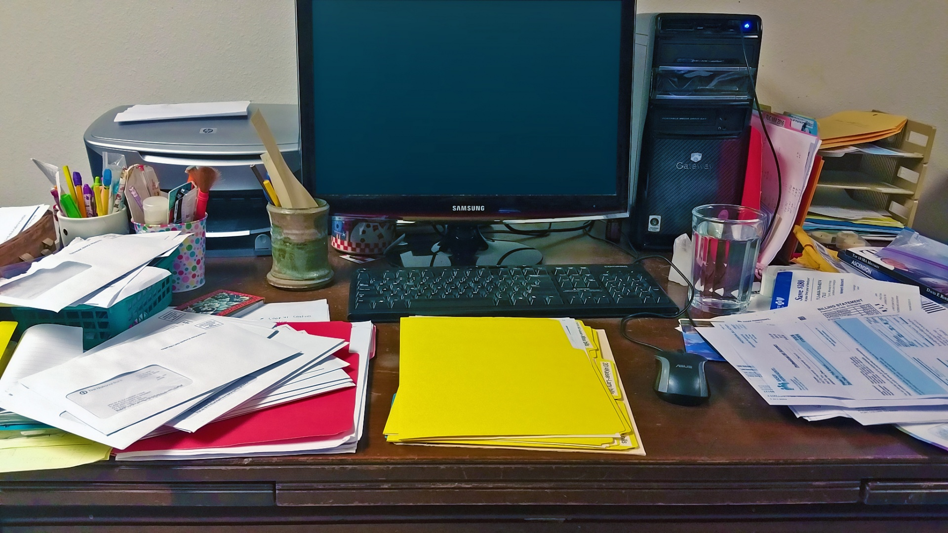
#3. Have a dedicated space to complete your work.
But make it neater than this one!
Notes:
2

Slide 8
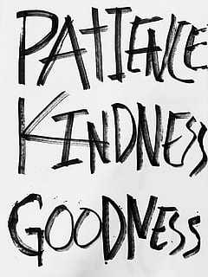
#4. Be kind to others.
Notes:
3

Slide 9
#5. Ask for help when you need it.
Notes:
4

Slide 10
#6. Make a schedule and
stick to it.
Notes:
8

Slide 11
#7. Get plenty of rest at night.
Notes:
7

Slide 12
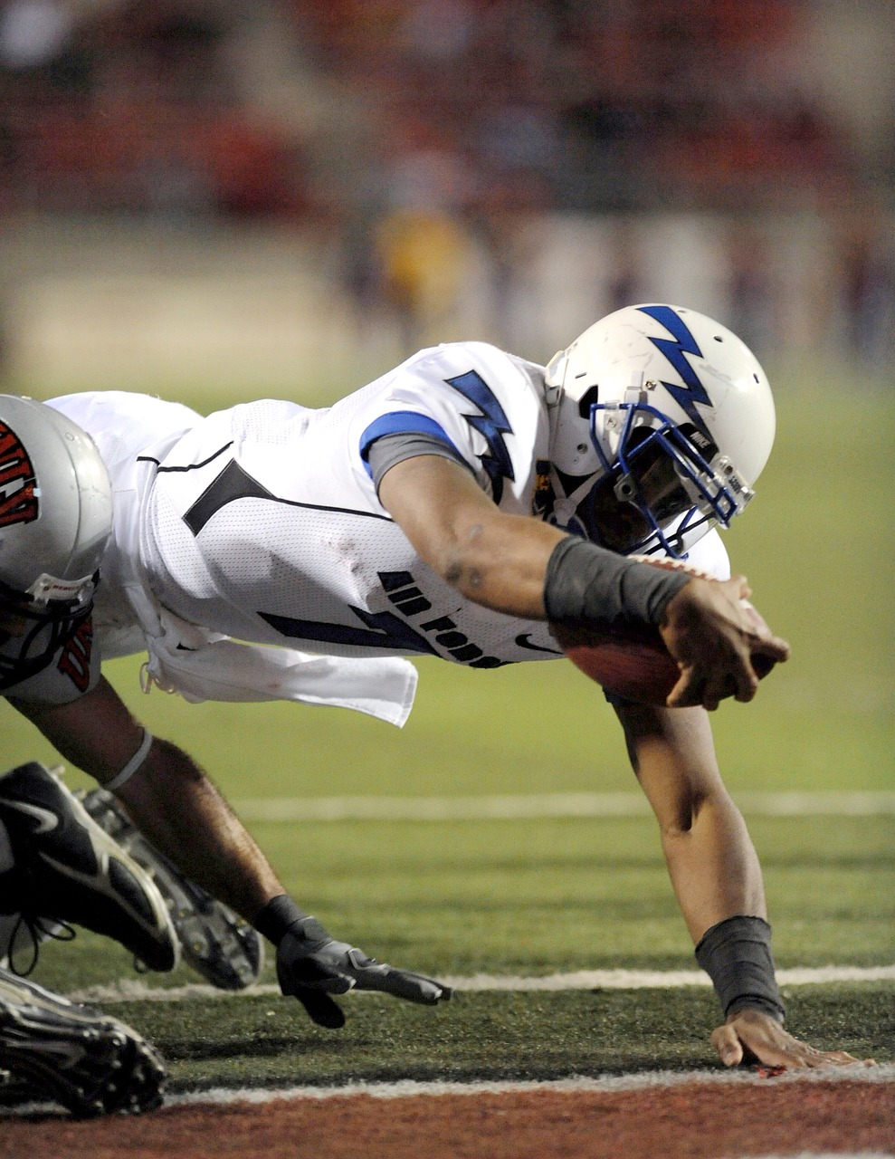
#8. Give your best effort.
Notes:
9

Slide 13
#9. Stay positive and believe in yourself.
Notes:
10

Slide 14
#10. Have fun and learn something new!
Notes:
6

Slide 15
Getting ready for the first day of school
Make sure your device is charged and ready
Have a positive attitude
Be ready to learn
Be ready to meet and make new friends
Check your teacher’s Canvas pages for the meeting codes for the virtual meetings
Notes:
Break out time for 1st period classes

Slide 16
First period teacher names and codes
Ford | mvms-jfordl-pd1
Kann | mvms-vkann-pd1
Stout | mvms-sstout-pd1
Otto | mvms-jotto-pd1
Bassolino | mvms-kbassolino-pd1
Sorenson | mvms-gsorenson-pd1
Walsh | mvms-bwalsh-pd1
But wait...there’s more...
Notes:
Parent Q and A

Slide 17
First period teacher names and codes
Dubbs | mvms-jdubbs-pd1
Kuruc | mvms-mkuruc-pd1
Grimes | mvms-sgrimes-pd1
DeBeal | mvms-mdebeal-pd1
Sindler | mvms-jsindlerl-pd1
Blum | mvms-cblum-pd1
Parson | mvms-nparsonl-pd1
Notes:
Parent Q and A

Slide 18
Q & A Time

