Slide 1
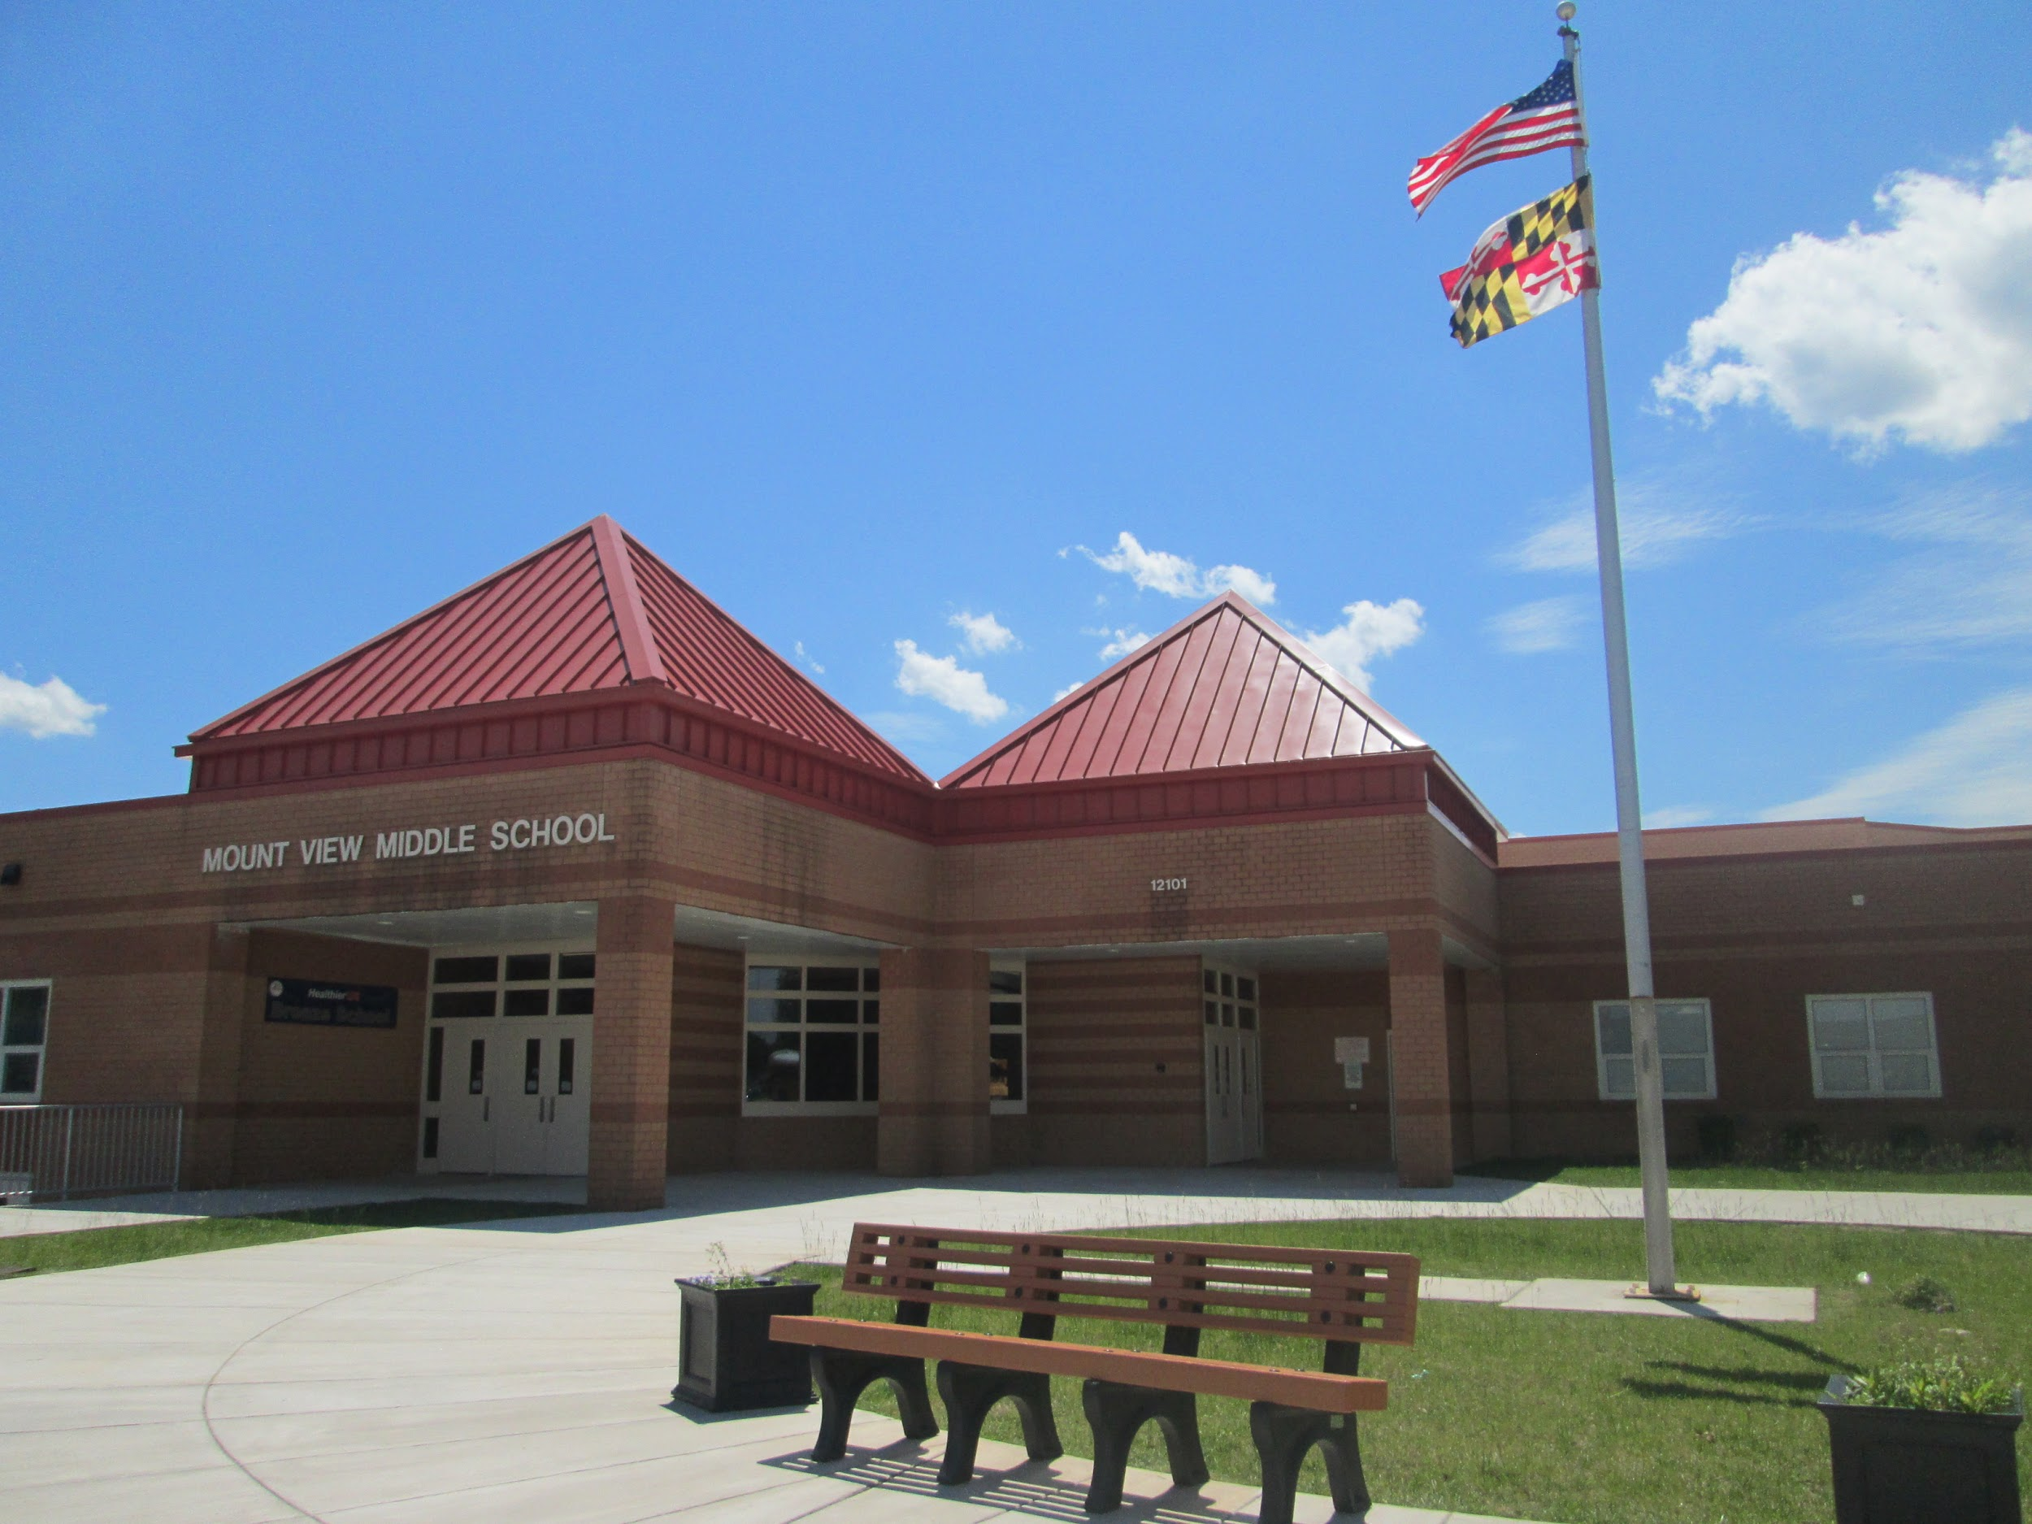
Welcome to
Mount View Middle School
Home of the Falcons
Notes:
Admin

Slide 2
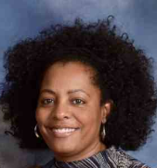
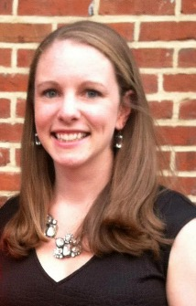
Your Administrative Team
Lynnette Moore, Principal Kimberly Hess, Assistant Principal
Notes:
Admin

Slide 3
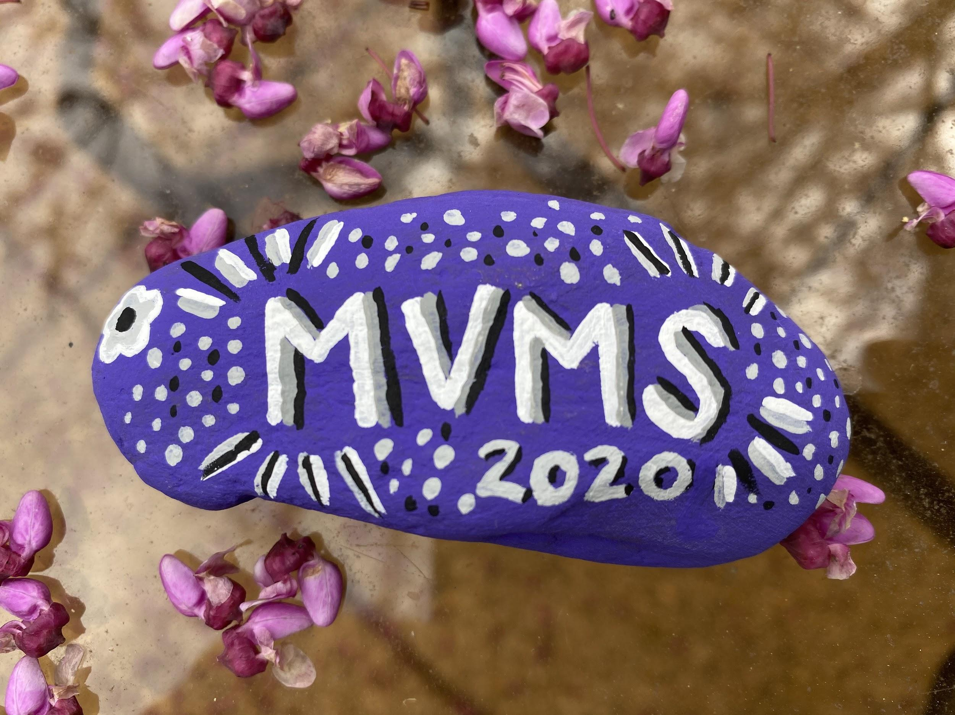
Mount View Mission Statement
Mount View Middle School is committed to academic excellence as we educate young adolescents in a safe and innovative environment in which we appreciate diversity and promote learning for a lifetime.
Notes:
Admin

Slide 4
Student Services Team
Mrs. Marton Mrs. O’Ferrall
6th Grade (Last names A - L) 6th grade (Last names M - Z)
8th Grade 7th Grade
Notes:
Student Services

Slide 5
SoaRRR Like a Falcon
R = Respectful
R = Responsible
R = Ready
Notes:
Sindler

Slide 6
PTA President: Phuong Dam
https://mvmspta.weebly.com
Notes:
PTA

Slide 7
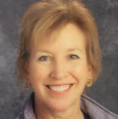
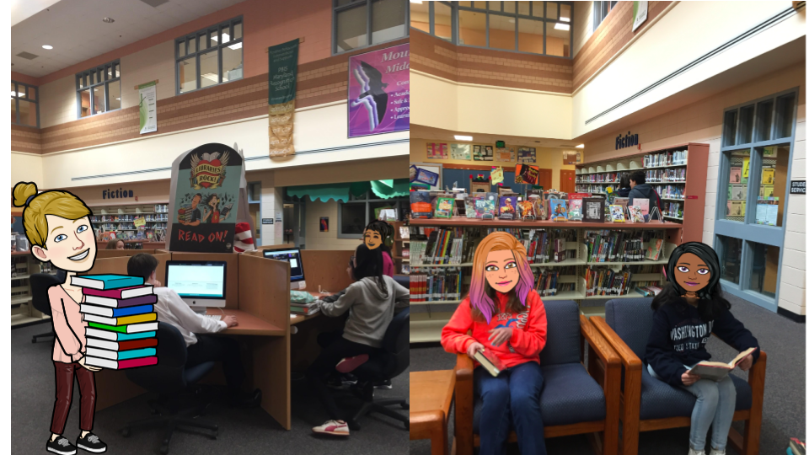
Library Media Center - Mrs. Finley
See MVMS Student Resources for Library Information
Orientation Next Thursday - Falcons To Read
Notes:
Finley

Slide 8
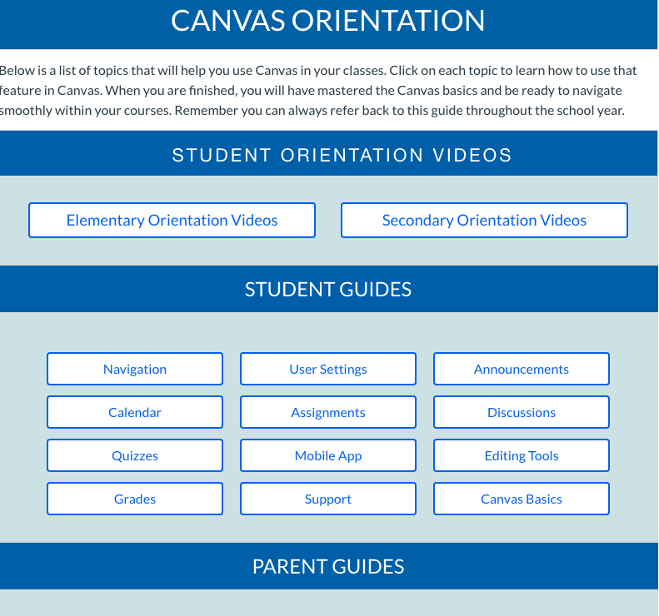
Getting to Know Canvas
https://hcpss.instructure.com/courses/9495
Canvas courses will be visible SEPTEMBER 5th. Teachers will send out Google Meet codes as course announcements AND put the codes on the Canvas calendar.
Notes:
Finley

Slide 9
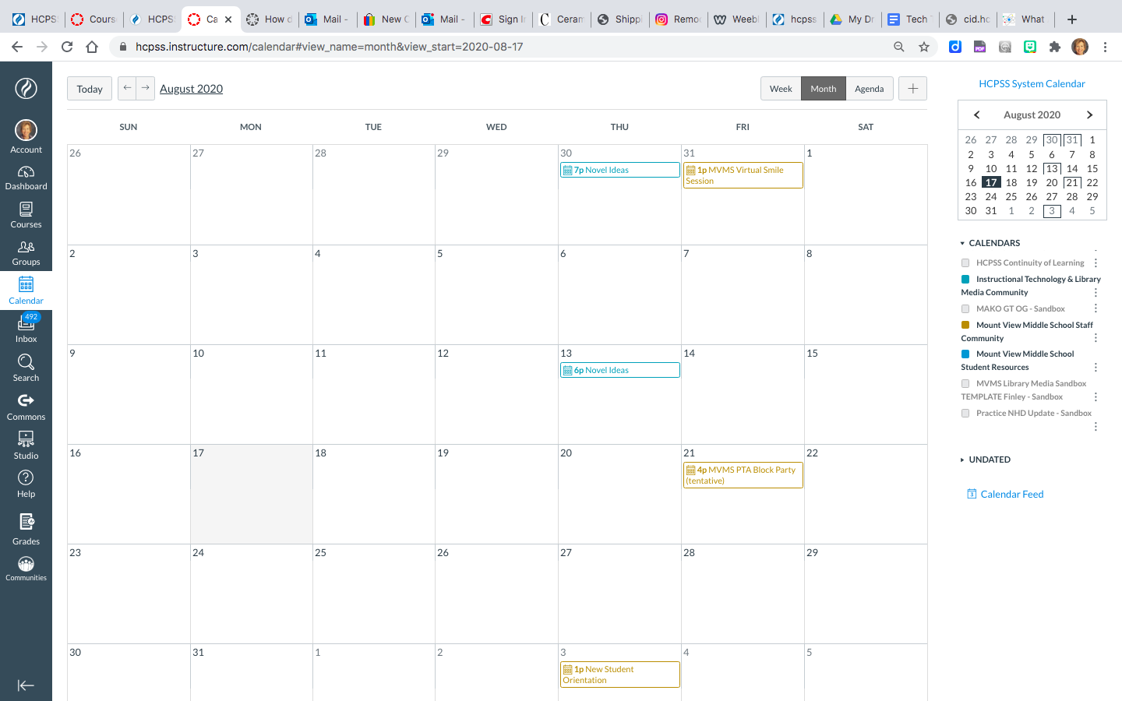
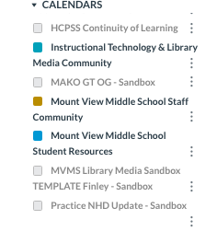
Set Up Course Calendar
On Canvas Calendar page:
Select your 4 fall semester courses, so colors appear in the boxes to the left of the course name.
Calendar events will appear on your calendar for any classes selected.
Remove the color box from any courses in which you are not currently participating.
Be sure Mount View Middle School Student Resources is selected. School activities are posted there.
Class Meet codes will appear on your calendar.
Notes:
Finley

Slide 10
Chromebook Troubleshooting
All students will receive a HCPSS issued Chromebook sometime during the 1st quarter.
Contact your teachers with problems related to a specific Canvas course or assignment.
Fill out the Technology Support Request Form if you need help with other technology issues. Set up your school account login or recover a forgotten password at hcpss.me.
Notes:
Finley: The tech support form is also available in the school newsletter, on the school website , in the Student Resource Course, and from your teachers. Please do not call or email with technology issues, the form is method for receiving assistance. Student can also independently set up and recover account passwords on hcpss.me

Slide 11
Student
Schedule
Download and customize your own copy!
https://docs.google.com/document/d/18aIKRa2bw_B8vNbf7MCUEKSrB3HpjM8ygaSO7-UDxNk/edit
Notes:
Hess

Slide 12
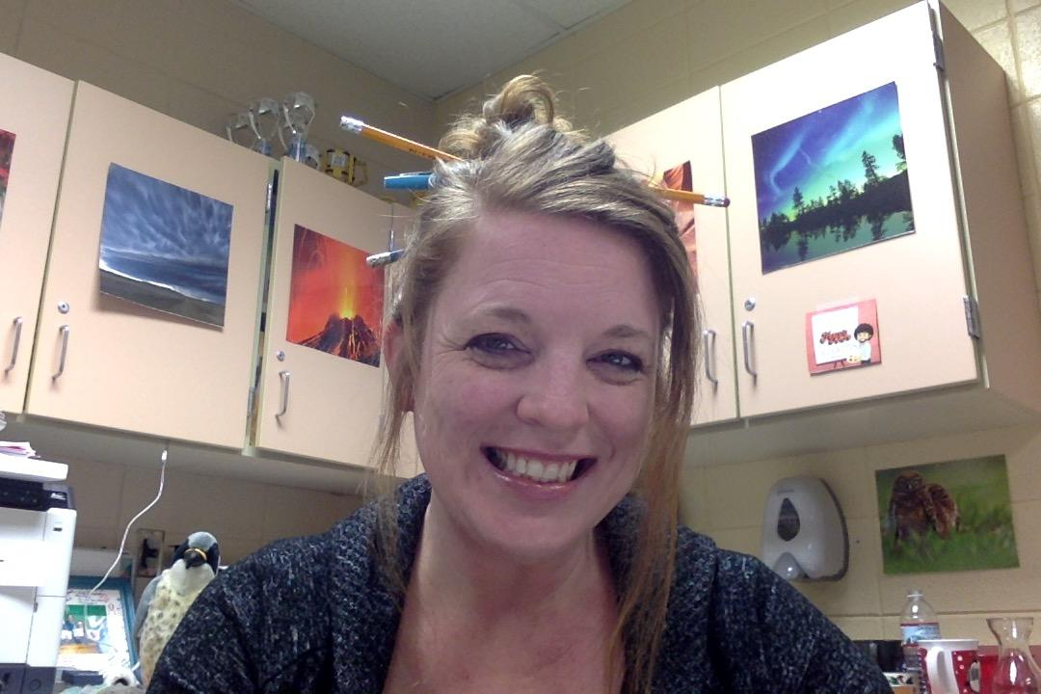
GT Seminars
Mrs. Mako
ALL students are invited and encouraged to participate in a GT seminar!
Seminars are designed to provide high-level enrichment opportunities for students to pursue their passions and extend their learning in areas of interest. Offerings range from TV Production to Debate. A student does not need to be enrolled in a GT content class in order to participate in a GT instructional seminar at MVMS! These classes take place primarily between 11am-noon. Signups begin September 14th. Descriptions of GT seminars can be found on the MVMS GT Website: www.mvmsmgt.weebly.com
Learn more at www.mvmsgt.weebly.com
Notes:
Mako

Slide 13
Meet the Related Arts Team
Ms. Bonner: Careers | Mrs. Grimes: Chorus and Music
Ms. Hall: Digital Citizenship | Mr. Sindler: Band
Mrs. Pearce: Family and Consumer Science (FACS) | Mrs. Bateman: General Music and Band
Mrs. Kuruc: Art | Mr. DeBeal: Orchestra
Mr. Mitchell: Art | Mrs. Marble: Health
Mrs. Balimtas and Mrs. Capecci: Reading Seminar | Ms. Kenney and Mr. Tucci: PE and Health
Notes:
Bonner, Hall, Pearce, Mitchell, Kuruc, Balimtas, Grimes, Sindler, Bateman, DeBeal, Marble, Kenney, Tucci

Slide 14
Meet the 6th Grade Team
English
Science
Mr. Jennifer
Mr. Klingler
Mr. Colonna
Mrs. Gavazzi
Mrs. Mezeivtch
Math
Geography
Mrs. Cutsail
Mr. Colonna
Ms. DeLitto
Mrs. Kupisch
Mr. Biniak
Mr. Grabau
Mr. Lewis
Notes:
Cutsail, DeLitto, Kupisch, Klingler, Jennifer, Colonna, Grabau, Lewis, Biniak, Gavazzi, Mez

Slide 15
Top 10 Tips For A Successful School Year
Notes:
Cutsail

Slide 16
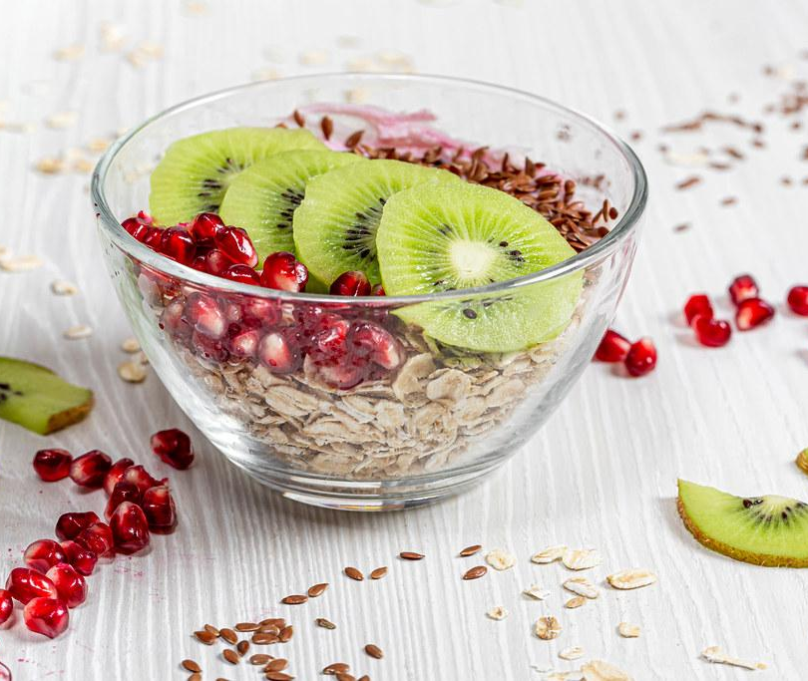
#1. Eat a healthy breakfast each morning.
Notes:
Lewis

Slide 17
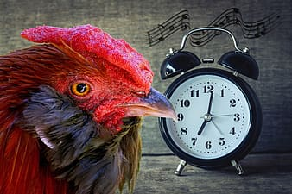
#2. Be on time for class.
Notes:
Mako

Slide 18
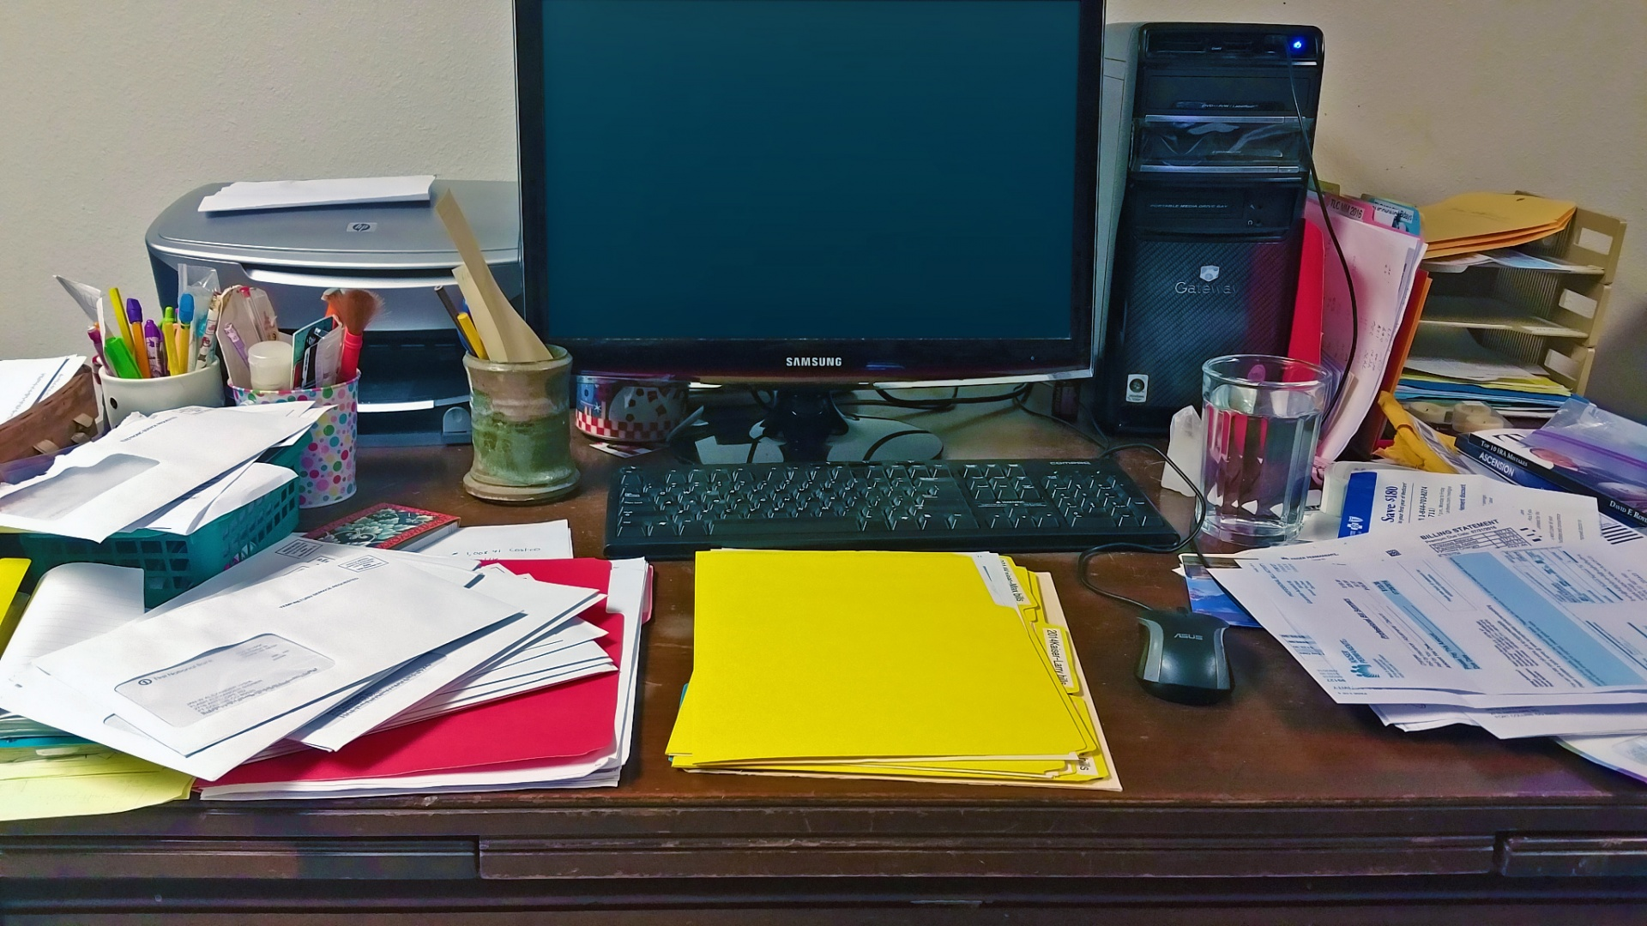
#3. Have a dedicated space to complete your work.
But make it neater than this one!
Notes:
Mez

Slide 19
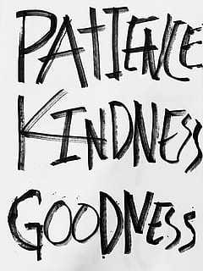
#4. Be kind to others.
Notes:
Klingler

Slide 20
#5. Ask for help when you need it.
Notes:
Gavazzi

Slide 21
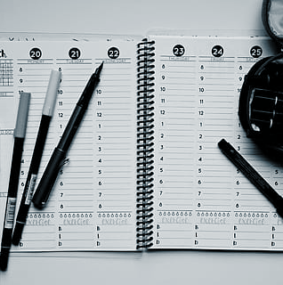
#6. Make a schedule and
stick to it.
Notes:
DeLitto

Slide 22
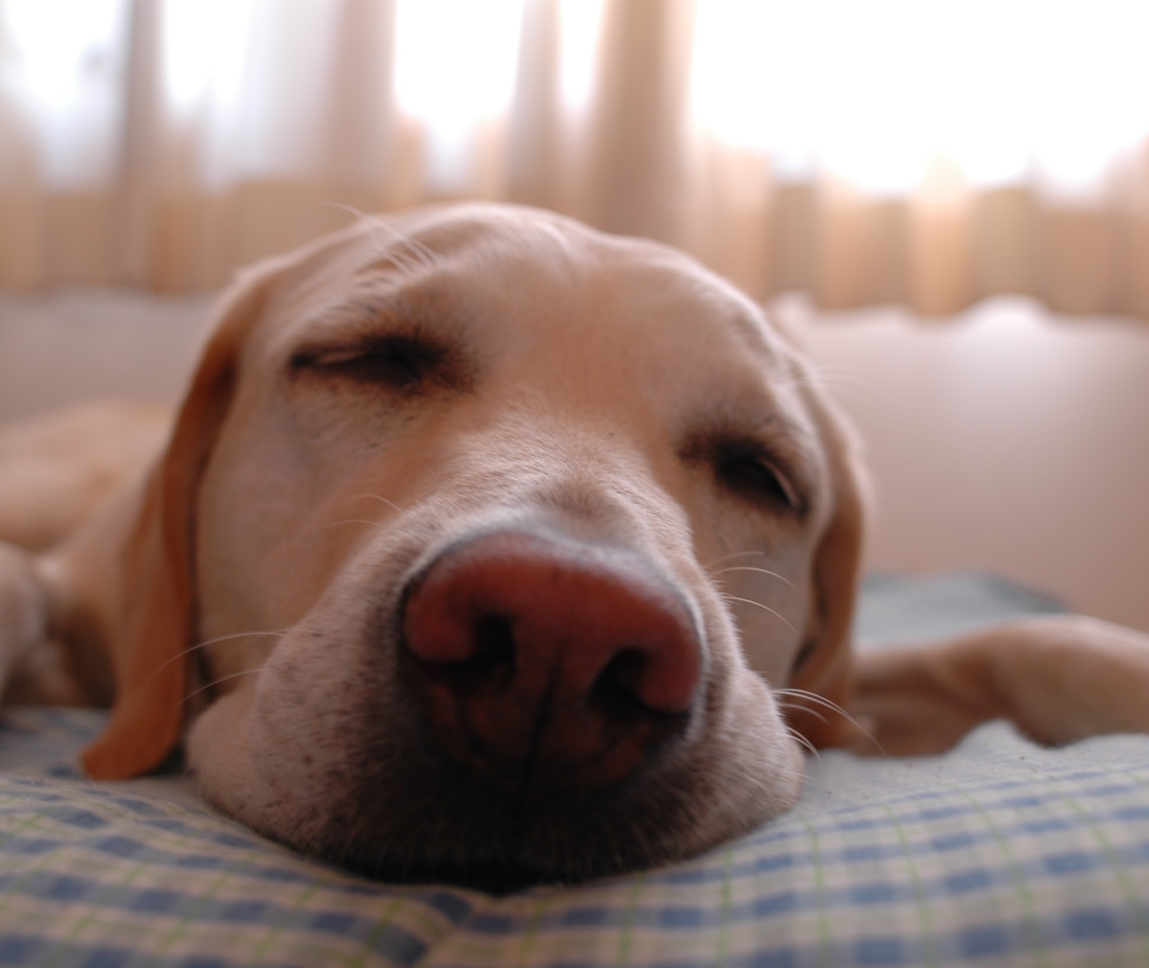
#7. Get plenty of rest at night.
Notes:
Cutsail

Slide 23
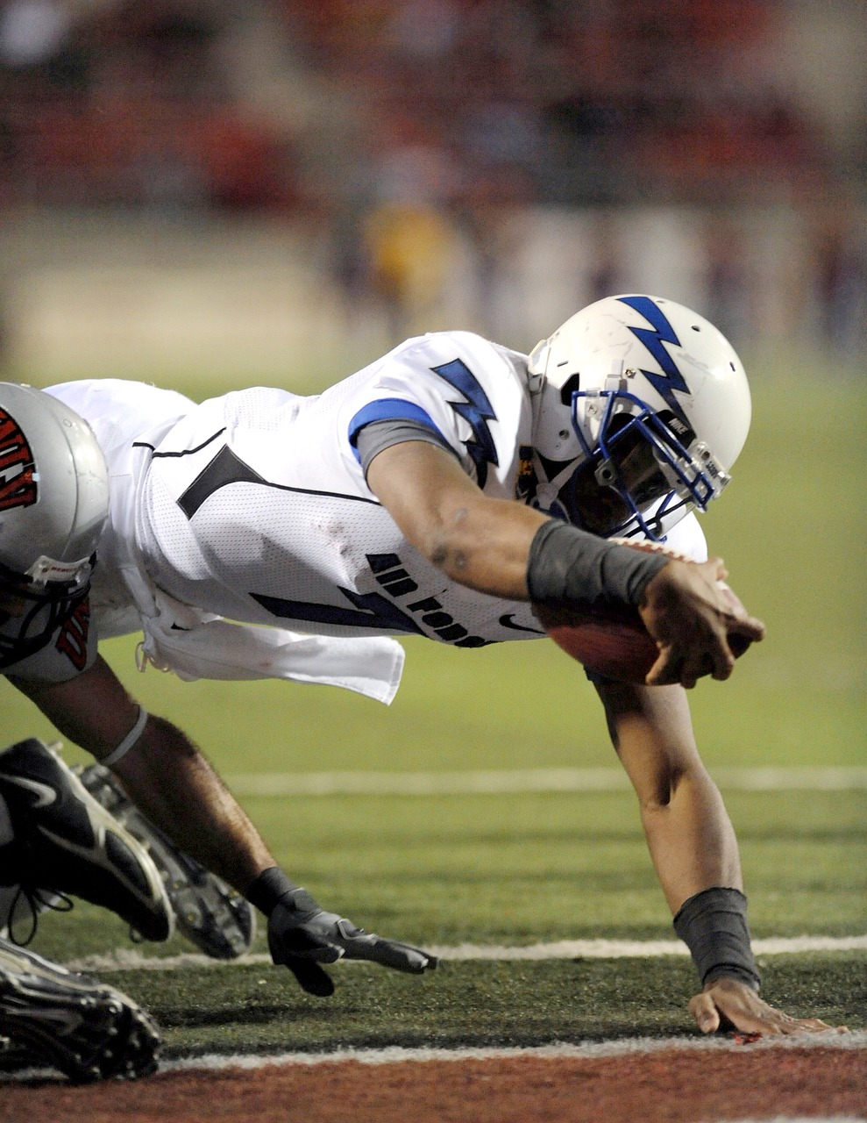
#8. Give your best effort.
Notes:
Jennifer

Slide 24
#9. Stay positive and believe in yourself.
Notes:
Grabau

Slide 25
#10. Have fun and learn something new!
Notes:
Lewis

Slide 26
Time for class!
Let’s practice going to first period. There, you can say hello to your teacher and ask any questions you may have. Leave this meet and go to the code listed on the next slide. Write it down before you leave so you don’t forget. If you don’t know your first period teacher, no worries. We have a place for you to go.
Notes:
Cutsail: Break out time for 1st period classes

Slide 27
First period teacher names and codes
Cutsail | mvms-ocutsail-pd1
DeLitto | mvms-cdelitto-pd1
Kupisch | mvms-mkupisch-pd1
Bonner | mvms-pbonner-pd1
Balimtas | mvms-rbalimtas-pd1
Lewis | mvms-slewis-pd1
Grabau | mvms-egrabau-pd1
But wait...there’s more...
Notes:
Cutsail

Slide 28
First period teacher names and codes
Mezeivtch | mvms-emezeivtch-pd1
Gavazzi | mvms-ggavazzi-pd1
Klingler | mvms-mklingler-pd1
Jennifer | mvms-jjennifer-pd1
Hall | mvms-khall-pd1
Notes:
Cutsail

