Slide 1
Welcome to Mount View Middle School

Slide 2
We are glad you are here!
Brief Introductions
A few words about middle school
Support for your middle school student and you
Information about important topics
Time to get to lockers and review the schedule

Slide 3
Introductions
Allen Cosentino – Principal
Kim Hess – Assistant Principal
Elaine Mezeivtch – 6th grade team leader
Angie Szalecki – 6th grade counselor
Mary Levinsohn-Klyap – PTA President

Slide 4
So you have a middle school student?
From the Washington Post on 8/21/18

Slide 5
How to be a parent in 2018
Make sure your children’s academic, emotional, psychological, mental, spiritual, physical, nutritional and social media needs are met while being careful not to over stimulate, under stimulate, improperly medicate, helicopter or neglect them in a screen-free, processed foods-free, GMO-free, negative energy-free, plastic-free, body positive, socially conscious, egalitarian but also authoritative, nurturing but fostering of independence, gentle but not overly permissive, pesticide-free two-story, multilingual home, preferably in a cul-de-sac with a backyard and 1.5 siblings spaced at least two years apart for proper development. Also don’t forget the coconut oil.

Slide 6
How to be a parent - previous generations*
Feed them sometimes

Slide 7
How to Identify a Middle School Student
Eye rolls, lip smacking, shoulder shrugs and heavy sighs are a form of communication
You are not cool anymore*
Nothing matters more than peer acceptance
“Fashion” is interesting
Dramatic body changes

Slide 8
How to Identify a Middle School Student
Everything is the most important thing that ever happened
Love private praise
Looking to be independent
They are still kids and they need you

Slide 9
What are you going to do?
Maintain a regular structure (Meals, homework, sleep, etc.)
Talk about school
Know your child’s friends
Monitor technology
Don’t solve their problems*
Love them! They still need you

Slide 10
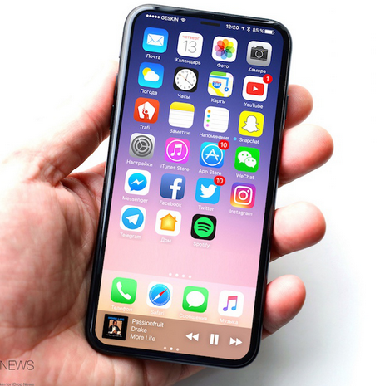
Technology & Bullying
Technology makes it easier
Monitor technology
Bullying & harassment will not be tolerated
Everyone is welcome and valued at Mount View
Sprigeo.com or green bullying form
Work hard and be nice

Slide 11
Bullying Prevention at MVMS
Peer conflict is not always bullying, but it is not OK
School-wide anti-bullying program
Vigilance by staff
Restorative Practices – Circles
Bullying decreases when people are connected
Purposeful time for students to create a caring community
In every class

Slide 12
MVMS FAQs
The School Day? 7:30AM – 2:25PM
Please ride the bus. Traffic is terrible.
Bus locator is on the HCPSS website > School Information> School Transportation > Find Your Bus Stop
Breakfast ($2.00) & Lunch ($3.25) are available.
Prepay meals with myschoolbucks.com
“Go To” websites HCPSS & MVMS

Slide 13
Outdoor Education
October 3 – 5
Sandy Hill Camp. North East, MD
September 13 – Parent volunteer forms due
September 20 - Parent Info Night 6:00 – 7:00PM
September 21 – Packets / Payment due
Cost - $165. Three days and two nights, t-shirt, transportation, activities and meals

Slide 14
Homeroom Lists
Last Name Range | Teacher | Room #
A - Borahay | Mrs. Gavazzi | Science 2 – Upper level
Botek - Dorsey | Mrs. Balimtas | Science 5 – Upper Level
Doshi - Hsu | Mr. Jennifer | Room 11 – Lower Level
Hull - Kraft | Mr. Klingler | Room 12 – Lover Level
Juehne – Nair, Shreyas | Mrs. Cutsail | Room 13 – Lower Level
Nair, Shruti - Ramanthan | Mr. Grabau | Room 14 – Lower level
Ranck - Shelat | Mr. Lewis | Room 15 – Lower Level
Shin - Walther | Ms. Nam | Room 16 – Lower Level
Warren - Z | Mr. Ford | Room 22B – Lower level*

Slide 15
Thank you for coming! Please join your student in homeroom

