Slide 1
Middle School
Gifted and Talented Program

Slide 2
Agenda
Overview of the Middle School G/T Education Program
Placement Process
How To Reach Me With Questions

Slide 3
Program Components
Talent Development Offerings
G/T Classes and Curricular Extensions
Extended Day/Extended Year Programs
Notes:
The comprehensive Middle School G/T Education Program consists of a
wide variety of offerings that fall into the 3 general categories: The Talent Development Model, G/T Classes and Curricular Extensions, as well as Extended Day/Extended Year Programs.

Slide 4
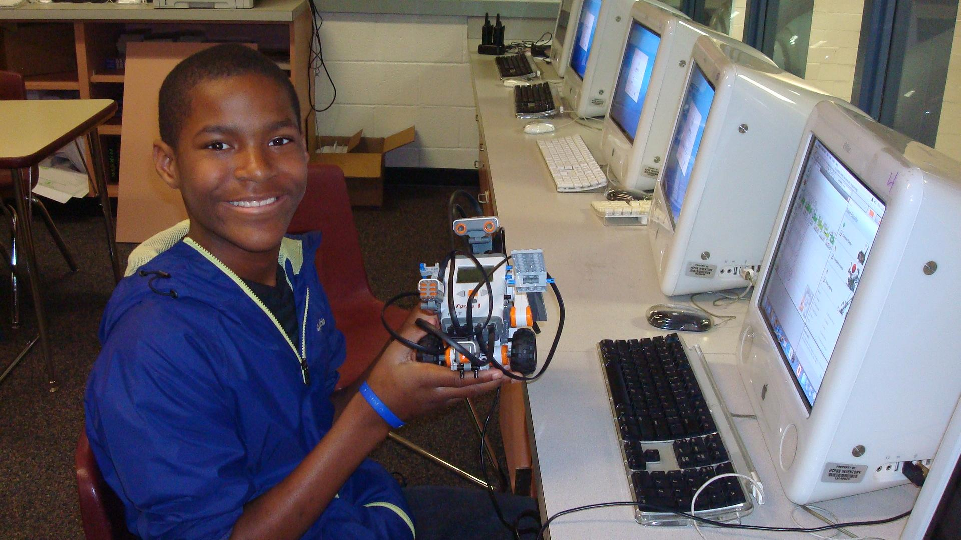
G/T Instructional Seminars
Notes:
Schools offer a wide variety of G/T Instructional Seminars. Middle School Book Club, Debate, and Television Production are offered at all middle schools. In addition, all schools offer at least one STEM-related seminar, such as Robotics, Coding, or Environmental Studies. (Describe other seminars offered at your school. You may include student presenters or displays, as you wish.)
Additional seminars are provided at each middle school that are designed specifically around
students’ areas of interest. Therefore, these vary across schools.
Topics might include some of those listed. Share the seminars you are offering.

Slide 5
Talent Development Offerings: G/T Instructional Seminars
Instruction in Advanced-Level Skills
Open to All Interested Students
Creative Production or Inquiry
Notes:
G/T Instructional Seminars are talent development offerings that are open to all interested students. Seminars offer instruction in advanced-level skills and include an authentic creative production or inquiry as the final product.

Slide 6
Where can I find out about G/T Instructional Seminars at my child’s school?
In the fall…
Announcement in Viewpoint
Announcement on Canvas
Announcement on Facebook (mvmsgt)
Visit 6th grade science classes
Available during lunch shifts
Notes:
Information about our school’s G/T Instructional Seminars are available on our G/T Program website. (Also mention if you send information home at the beginning of the year, student orientations, etc.)

Slide 7
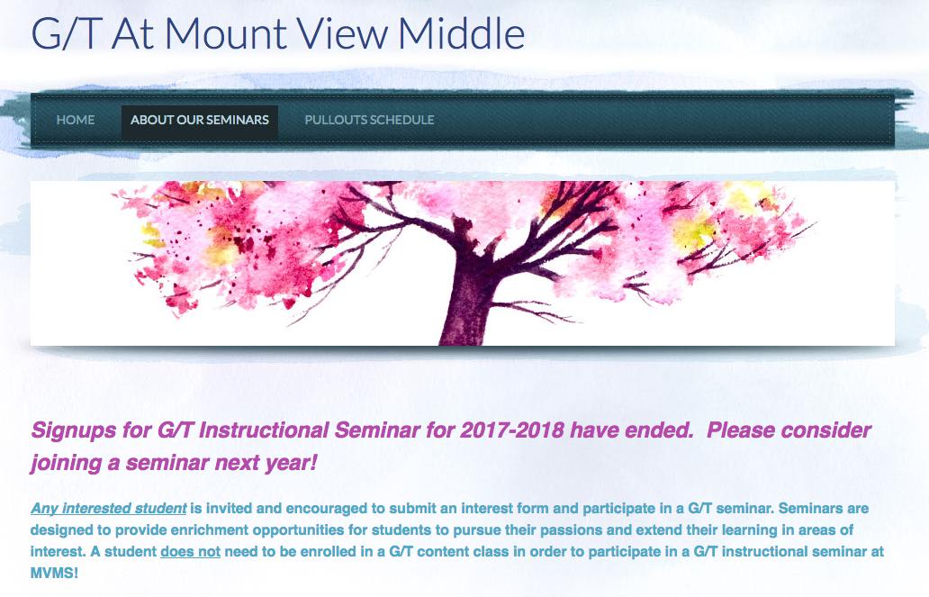
Where can I find out about G/T Instructional Seminars at my child’s school?
www.mvmsgt.weebly.com
Notes:
Information about our school’s G/T Instructional Seminars are available on our G/T Program website. (Also mention if you send information home at the beginning of the year, student orientations, etc.)

Slide 8
G/T Content Classes
Accelerated and/or Enriched Curriculum
Advanced-Level Content
Inquiry-Based Instruction
Application of Knowledge
Notes:
G/T Content Area classes offer an accelerated and/or enriched curriculum and advanced-level content. Teachers focus on the application of knowledge through inquiry-based instruction.

Slide 9
Middle School G/T Classes
G/T Math
G/T Science
G/T English
G/T Social Studies
Notes:
Placements in G/T classes are academic placements based on the needs of each individual child.
There are 4 G/T content area classes - Eligible students can choose to participate in one, two, three, or all 4 classes. The number of classes in which eligible students participate greatly depends on the individual child. While, it is very appropriate for some 6th graders to participate in all 4 classes of eligibility, it is also it is appropriate for other students to choose to participate in selected classes that are of the greatest interest. Eligibility to participate in a class extends to 8th grade.
Therefore, a child who may select to participate in G/T English and math in 6th grade, may choose to add G/T science as a 7th grader, if he or see was originally eligible.
Students who participate in G/T classes in middle school are expected to participate In high school G/T and Advanced Placement courses.

Slide 10
G/T Mathematics
Provides an accelerated and enriched sequence that follows a curriculum of concepts at least two years above the general education curriculum.
6 - Pre-Algebra G/T
7 – Algebra I G/T
8 - Geometry G/T
Notes:
Grades for Algebra 1 and Geometry will be placed on the students official high school transcript and will be part of the transcript that eventually accompanies college applications. The grades however, will not be calculated into the students high school GPA.
NOTE: If asked about Accelerated Math, please refer all questions to the G/T Education Program Office at 410-313-6800.

Slide 11
G/T English
Extends the Maryland College and Career Ready Standards for English Language Arts through
an accelerated pace,
reading and analyzing challenging and complex literature and literary nonfiction independently,
writing a variety of interpretive,
and analytical pieces, and conducting independent research.
Differentiated tasks and texts are included at all grade levels.
Notes:
Successful G/T English participants are avid readers and writers and have demonstrated an advanced-level ability in both areas. Participating students read advanced-level selections; therefore, they should all be above level readers. Differentiated texts are one of several ways that the G/T English curriculum is enriched and extended for advanced-level learners.

Slide 12
G/T Social Studies
Provides an enriched and accelerated curriculum, including differentiated objectives, where students explore civic and cultural principles and engage in inquiries that focus on essential, related questions.
6 – Geography and World Cultures G/T
7 – Geography and World Cultures G/T
8 – United States History G/T
Notes:
Successful participants in G/T social studies are students who demonstrate a curiosity and interest in topics related to history, culture, and current events. These students demonstrate their interest in a variety of ways that may include asking insightful questions and/or grappling with issues during discussions of related topics.
In addition to the differentiated objectives, students who participate in G/T social studies complete inquiry tasks each year. One of these may be presented for feedback from professionals in a forum such as National History Day.
Participating students should be avid readers and writers with advanced-level skills in both areas.

Slide 13
G/T Science
An enriched and accelerated curriculum where students explore cross-cutting concepts, as well as science and engineering practices.
6 – Earth Science G/T
7 - Life Science G/T
8- Physical Science G/T
Notes:
Successful participants in G/T science are students who have an advanced-level background knowledge in scientific topics and ask insightful questions in scientific areas. Students do not have to be in G/T math or above-level math in order to participate in G/T Science.

Slide 14
Extended Day/Extended Year
Accelerated Mathematics
Visual Arts - G/T Art
G/T Orchestra, G/T Symphonic Band, and G/T Chorus
G/T Summer Institutes for Talent Development
Notes:
These are additional offerings that are available to middle school students.

Slide 15
Middle School GT Research Class
Authentic research to address real-world problem
For students enrolled in G/T Math and G/T English based upon G/T Placement Committee recommendations
Notes:
The middle school G/T Research curriculum is offered in all middle schools for
6th graders who participate in G/T English and G/T Math based upon recommendations through the G/T Placement Process. The focus of this curriculum is on primary research methods. Therefore, students learn how to design and use instruments to collect data and various statistical measures to analyze the data.
Students develop a deep understanding of how to use primary research methods so that they can be applied to a research investigation of the student’s own design. This was described earlier when we discussed G/T Research Investigations and Creative Productions. Students transfer many of the skills taught in this class to assignments long-term Projects in their other G/T content area classes.
POSSIBLY USE A STUDENT PRESENTER TO HIGHTLIGHT A REMARKABLE INVESTIGATION OR
DESCRIBE ITS REMARKABLE COMPONENTS FOR THE PARENTS.

Slide 16
Research
Original
Primary Research Methods
Authentic Product
Authentic Audience
Contribution to the Community/Field
Notes:
Any student may conduct a research investigation with the support of the G/T Resource Teacher. Students explore a real-world problem and work to develop authentic solutions.

Slide 17
Placement Process For Middle School G/T – 5th Grade
5th Grade
CogAT administered to ALL students in December.
Meets State COMAR requirement for an ability measure.
Helps identify students who may underperform in school.
No longer requires parent/teacher request for testing.
All students reviewed as part of G/T Placement Process.
Notes:
All students in HCPSS took the Cognitive Abilities Test (CogAT) in December of their 5th grade year. The CogAT is an ability measure (not an achievement test) that is used as an initial indicator of eligibility for G/T content area classes. If a student is not eligible based upon the CogAT scores, elementary teachers automatically reviewed the placement, using multiple performance criteria, such as other assessments and student work samples. Each elementary school team makes recommendations and communicates those in writing.
Students who are new to Howard County and did not take the CogAT in 5th grade, will be given The School and College Ability Test (SCAT) in order to determine initial eligibility for G/T content area classes. Test results will be communicated in writing.

Slide 18
Parental Input in Placement Process
If after reviewing the Placement Committee's professional recommendation, parents/guardians still wish to enroll their students in one or more G/T classes, they may complete the Course Placement Review form.

Slide 19
Who can initiate the placement process in middle school?
Families
Teachers
Students
Notes:
Teachers are continuously assessing readiness for all students throughout middle school. In addition, once a student has been tested, parents, guardians, and or a student may request a review of a child’s placement by submitting a written request to the G/T Resource Teacher.

Slide 20
Measures Included in Placement Process
Ability Measure (CogAT or SCAT)
Standardized assessments (MAP, PARCC)
Student work samples
Interpretation
Critique
Analysis
Creative Problem Solving
Student grades on assignments requiring critical, analytical, and/or creative thinking
Documentation from families
Notes:
A placement review team that consists of content area teachers, an administrator, and the Gifted and Talented Resource Teacher will review the multiple sources of data for your child and will communicate the placement decision to you in writing.
Parents and or guardians may provide additional information and work samples to the school to be considered in the review process.

Slide 21
Extended Day/Extended Year
Accelerated Mathematics
Visual Arts - G/T Art
G/T Orchestra, G/T Symphonic Band, and G/T Chorus
G/T Summer Institutes for Talent Development
Notes:
These are additional offerings that are available to middle school students.

Slide 22
Opportunities for Parent Engagement
HCPSS G/T Website:
www.hcpss.org/academics/gt
G/T Parent Academies
HCPSS News for G/T Program Information
HCPSS_GT Twitter

Slide 23
Contact Information
Susan Mako
410 313-5545
susan_mako@hcpss.org

